Slide 1

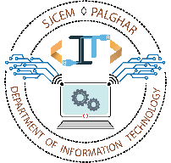
Airline Reservation System
Aldel Education Trust’s
St. John College of Engineering and Management, Palghar
NAAC Accredited with Grade A (2017-2022)
Department of Information Technology
Siddhesh Santosh Chavan EU1194007 (01)
Reenav Keshav Hemaria EU1194028 (07)
Aishwarya Ajay Ingale EU1194033 (08)
Shubham Virendra Kerkar EU1194042(12)
Mrs. Linda John
(Assistant Professor)
December 14, 2020

Slide 2
Contents
Introduction
  Motivation
  Problem Statement
  Objectives
  Scope
Review of Existing Literature
Proposed System
  Block diagram of Proposed System
Implementation
  Algorithm/Flowchart
  Pseudo code
  Screenshots of the output with description
  Technologies Used
  Results and Discussion
  Conclusions
  References

Slide 3
Abstract
The project has been developed to carry out the processes of reservation of flights and scheduling of flights. It also includes the conventional way to save data. Passport information and criminal’s record. The Airline reservation system take over a project based on this technology. The project is analyzed about requirements about the reservation system of flights. In this project we are using java core language and MySQL as database
Keywords—Airline Reservation, online reservation system,Java.

Slide 4
Introduction
An airline reservation system (ARS) is part of the so-called passenger service systems (PSS), which are applications supporting the direct contact with the passenger.
ARS eventually evolved into the computer reservations system (CRS).
A computer reservation system is used for the reservations of a particular airline and interfaces with a global distribution system (GDS) which supports travel agencies and other distribution channels in making reservations for most major airlines in a single system.

Slide 5
1. Motivation
Today all persons are busy with their schedule and no one have time to make a trip for holidays with their family. And this Airline Reservation Process is very difficult to understand in General meaning. But we are providing a Solution for that Problem. This system provides a facility to easy access towards a customers and a real time users. They can easily connected through it and just 3 steps. There is no requirement for any type of Agent. We are giving a all this facility in one project “Airline Reservation System”.

Slide 6
1.2 Problem Statement
The current system is manual, this system is slow, time consuming and it is very difficult for each person to book through office agents. Users inquire about the tickets through phones and it is very difficult for the user to remember all the details that they received through phones. It is very difficult to calculate how many peoples registered and how many seats on a particular plane are vacant .This requires quite a lot of time and wastage of money as it requires quite lot of manpower to do.

Slide 7
1.3 Objectives
The objectives are as follows:
To make the airline information system online based.
To reduce number of registers and documents.
To enable the passengers to save their time by using quick reservation.
Easy to maintain the records.
To reduce the time needed to reduce this job.
To store the data in organized form.

Slide 8
1.4 Scope
We are trying to give a live reporting which is updated by Airline Companies so that customer gets a live Flights checking, Available seats, Pricing and also planning to provide seats as per theirs choice so that they can travel very comfortably their journey. We will trying to provide food facility and choice to customers so that they can feel like their home and more effective amenities. We are also trying to make more attention on Business class people and their requirements. Our future planning is to take this project towards an AndroidApp and QR Code Scanning. So that a Customer can easily contact to the Airlines and they are getting quick Services from Airlines. We also want in future to place in market so that customer can take more advantages and saves their important time. We are also finding and approaching to companies which are using this type of software.

Slide 9
Literature Review
Title: - To decrease manual stress for reservation of flight. A literature survey/ review.
Authors names: - Anuradha Prajapati, Kirti Dhirwani, Manisha Agarwal, Nandita Gurwara, Seria Tak
Journal name: - International Journal of research advanced ideas and innovation in technology.
DESCRIPTION: - The survey is based on the decrease manual stress and increase the use of technology. From anywhere you can book tickets without wasting your time.
ADVANTAGE: - Decrease manual stress
DISADVANTAGES: -Failure to travelers to chose a seat for their picked flight Chapter 3

Slide 10
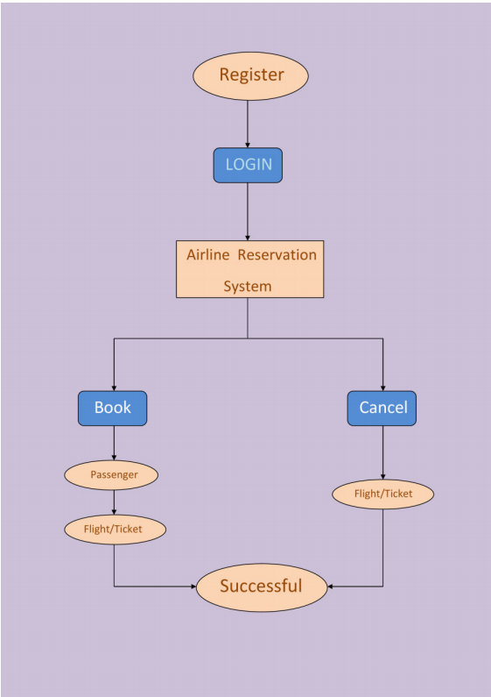
Proposed System
Block diagram of Proposed System

Slide 11
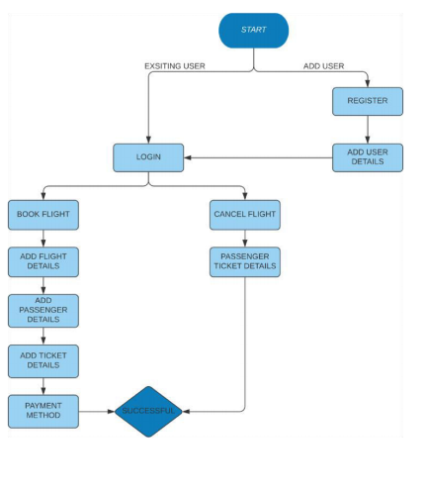
Implementation
Algorithm and flow chart.

Slide 12
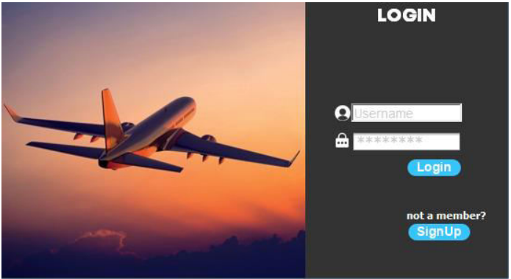
Screenshots of the output with description
Login Page: You can login through using your username and password, And if you are not a member you can sign up by clicking on sign up button.

Slide 13
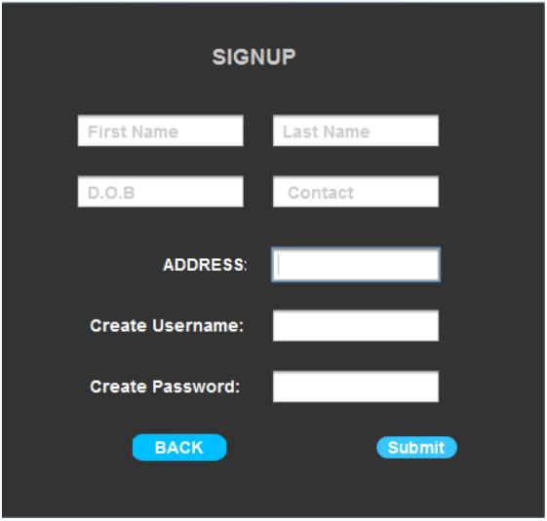
Registration Page: After clicking on sign up button you will be redirected to “Registration Page”. On this Page you have to put all your credentials as asked on the page and you have create a username and password for your account.

Slide 14

Option Page: Here the user can choose between booking a flight or cancelling a flight ticket.

Slide 15

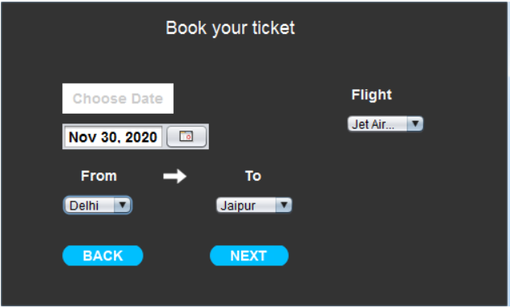
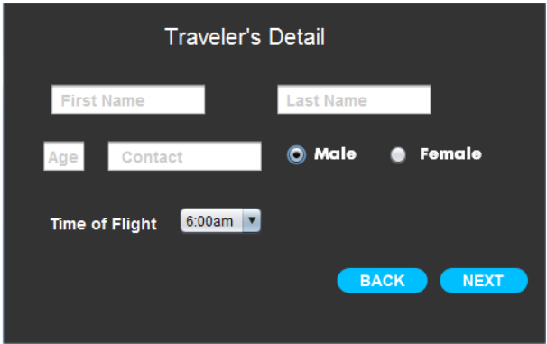
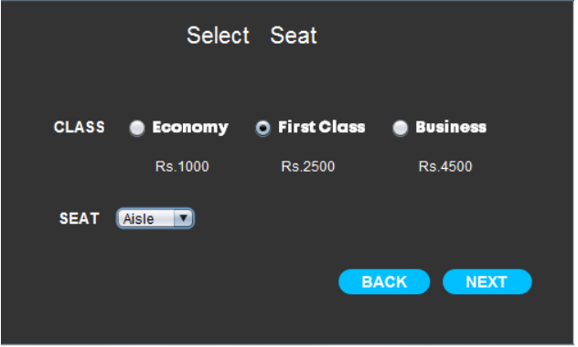
Booking pages: After successful login you can book your tickets as per your convenience.

Slide 16
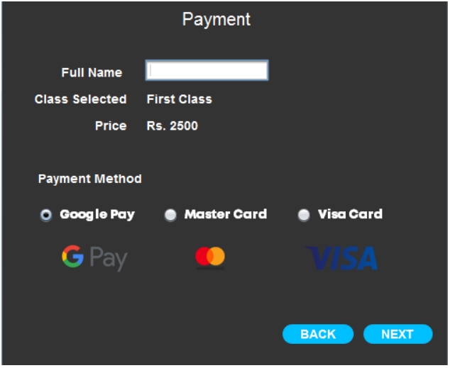
Payment Page: After Booking your ticket payment page will appear. Here you have to enter your payment credential and select your payment method.

Slide 17
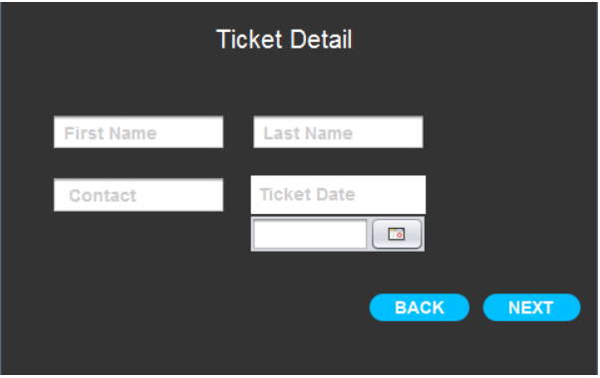
Cancel Page: Here you have to enter your ticket and passenger details to cancel your booked flight ticket if you want to.

Slide 18
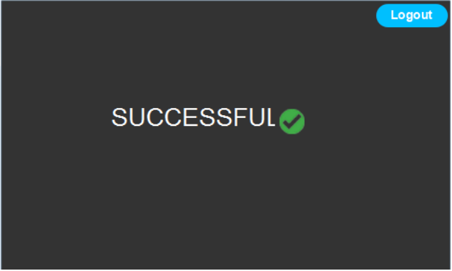
Successful: After successfully booking/cancelling your ticket this successful page will appear. By clicking on logout button you will be redirected to login page.

Slide 19
Technologies Used
1. Apache Netbeans IDE 12.1
2. MySQL Workbench 8.0 CE
3. PC with i3 Processor,4GB RAM.

Slide 20
Results and Discussion
On the basis of the implementation, your results can be discussed.
Performance measures can be calculated.
Results in the form of graphs and comparison with existing systems through graphs would be great.

Slide 21
Conclusion
The “Airline Reservation System” was successfully designed and is tested for accuracy and quality. During this project we have accomplished all the objectives and this project meets the needs of the organization. The developed will be used in searching, retrieving and generating information for the concerned requests. The advantages that are with this proposed system are Reduced entry work, Easy retrieval of information ,Reduced errors due to human intervention, User friendly screens to enter the data, Portable and flexible for further enhancement ,Web enabled and Fast finding of information requested.

Slide 22
References
1. Java Complete Reference by Herbert Shield
2. Database Programming with JDBC and Java by George Reese
3. Java and XML By Brett McLaughlin
4. Wikipedia, URL: http://www.wikipedia.org.
5. Answers.com, Online Dictionary, Encyclopedia and much more, URL: http://www.answers.com
6. Google, URL: http://www.google.co.in
7. Project Management URL: http://www.startwright.com/project.html

Slide 23
Thank You !!!

Slide 24
Q & A

